Slide 1

Project Presentation

Slide 2

The Problem:
How many times did you buy a clothing item online, got really exited and then got super disappointed when it arrived, and it didn't fit as well as you imagined?
Unfortunately - While buying clothes online, it is difficult for a customer to select a desirable outfit in the first attempt because they can’t try on clothes before they are delivered physically.

Slide 3

The Solution:
E-commerce websites can be equipped with virtual dressing rooms that allow users to try on multiple clothes virtually and select the best-looking outfit.
It's never been easier to look fabulous!!!

Slide 4

The Approach:
I created a Virtual clothing assistant using Deep learning algorithms in order to help the consumers.
The user can select the cloth he/she wants to wear and then upload his/her image of any pose they want, and the assistant will help to dress that human with his/her selected cloth.

Slide 5

So how exactly does it work?

Slide 6
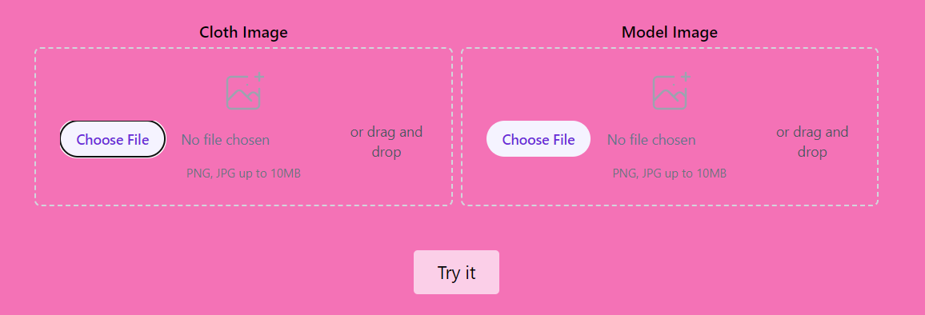
Input
We allow the user to upload his/her image and their clothing item’s image.

Slide 7
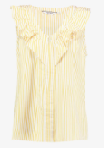

Cloth mask
We create a cloth mask with U2Net.

Slide 8
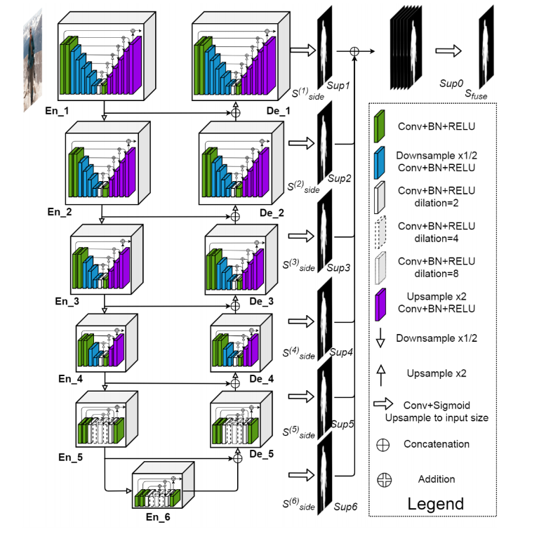
What is U2Net?
U2Net is a deep neural network architecture for image segmentation tasks, based on a U-shaped encoder-decoder network structure with nested U-shaped blocks. It uses a "salient object sub-network" with attention mechanisms to highlight important regions in the image and has achieved state-of-the-art results in various benchmark datasets for salient object detection and other image segmentation tasks.
U2Net was proposed in a paper titled "U2-Net: Going Deeper with Nested U-Structure for Salient Object Detection" by Qin et al. in 2020.
You can see the implementation of U2Net in model/u2net.py file in the project.
Notes:
Salient object sub-network is a deep learning model that identifies visually distinctive regions of an image.

Slide 9
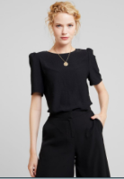
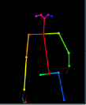
Body position
We get a body position estimation and key points with OpenPose.

Slide 10
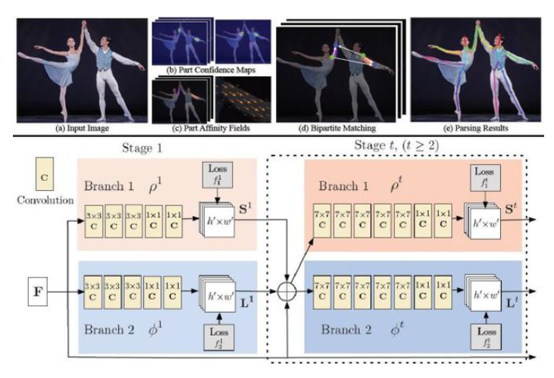
What is OpenPose?
OpenPose is a real-time multi-person key point detection library for body, face, and hand estimation. It detects and tracks key points on a person's body, face, and hands in real-time from video streams or images using deep learning and computer vision techniques. It has been used in various fields such as robotics, augmented reality, and sports analysis, and is available as an open-source library with APIs for Python, C++, and MATLAB.

Slide 11
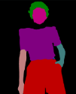
Body segmentation
We segment the user body with U2Net.

Slide 12
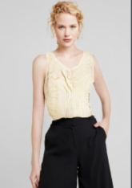
Generating the result
ALIASGenerator
These are used to create a new image of the user wearing the requested cloth item. The image is created using ALIASGenerator.

Slide 13
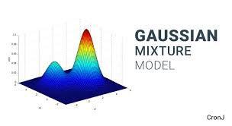
What is ALIASGenerator?
the ALIASGenerator is a component of the GMM network* used for image generation, specifically for generating a latent code for the appearance of the clothes. It uses an adaptation of the Alias Method to sample from a Gaussian mixture distribution, allowing it to generate diverse and realistic appearance codes for the virtual try-on image.
You can see the implementation of the generator in model/network.py file in the project.
*GMM (Gaussian Mixture Model) is a type of generative model that is commonly used for image and data generation tasks. A GMM network consists of several Gaussian distributions that are combined to model the distribution of the data.
Notes:
The ALIAS method is a technique used to generate random variables with specified probability distributions. It works by constructing two arrays, one of probabilities and another of alias values, and comparing a randomly generated integer to the probabilities array to select an outcome. It is a simple and efficient method commonly used in computer simulations.

Slide 14
The Result

Slide 15
Let’s see it in action:
Need to insert here video of using the app.

